Slide 1
AI for Medicine
Lecture 22:
Recommendation Systems
April 13, 2022
Mohammad Hammoud
Carnegie Mellon University in Qatar

Slide 2
Today…
Last Wednesday’s Session:
  Ranked Retrieval– Part II
Today’s Session:
  Recommendation Systems
Announcements:
  Assignment 5 will be posted by Sunday, April 17 (no need to submit it; it is just for practicing purposes)
  Project presentations (with demos) are on April 20 during the class time
  Final project deliverables (i.e., code, data, slides, and documentation) are due on April 21 by midnight

Slide 3
Outline
Recommendation Systems
Problem Definition
Content-Based Systems
Collaborative Filtering

Slide 4
Problem Definition
Let us define the problem of recommendation systems through an example where we have sets of diseases and patients as follows
 | Patient 1 | Patient 2 | Patient 3 | Patient 4 | Patient 5 | Pateint 6
Disease 1 | 1 | 1 | ? | ? | ? | ?
Disease 2 | 1 | ? | ? | 0 | 0 | 0
Disease 3 | ? | 0.7 | 0 | ? | ? | ?
Disease 4 | ? | ? | 0.9 | 0.75 | 0.8 | 1
Disease 5 | 0 | 0 | 1 | 1 | 1 | 1
Any value, if present, is a probability between 0 and 1, whereby:
0 means that a patient (e.g., Patient 1) had 0% probability of having a disease
(e.g., Disease 5) when they were diagnosed in the past

Slide 5
Problem Definition
Let us define the problem of recommendation systems through an example where we have sets of diseases and patients as follows
 | Patient 1 | Patient 2 | Patient 3 | Patient 4 | Patient 5 | Pateint 6
Disease 1 | 1 | 1 | ? | ? | ? | ?
Disease 2 | 1 | ? | ? | 0 | 0 | 0
Disease 3 | ? | 0.7 | 0 | ? | ? | ?
Disease 4 | ? | ? | 0.9 | 0.75 | 0.8 | 1
Disease 5 | 0 | 0 | 1 | 1 | 1 | 1
Any value, if present, is a probability between 0 and 1, whereby:
1 means that a patient (e.g., Patient 1) had a disease (e.g., Disease 2) with 100%
probability when they were diagnosed in the past

Slide 6
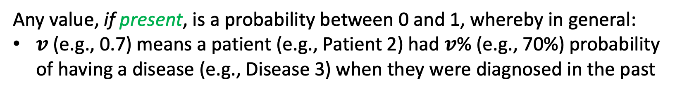
Problem Definition
Let us define the problem of recommendation systems through an example where we have sets of diseases and patients as follows
 | Patient 1 | Patient 2 | Patient 3 | Patient 4 | Patient 5 | Pateint 6
Disease 1 | 1 | 1 | ? | ? | ? | ?
Disease 2 | 1 | ? | ? | 0 | 0 | 0
Disease 3 | ? | 0.7 | 0 | ? | ? | ?
Disease 4 | ? | ? | 0.9 | 0.75 | 0.8 | 1
Disease 5 | 0 | 0 | 1 | 1 | 1 | 1
Any value, if present, is a probability between 0 and 1, whereby in general:
$v$(e.g., 0.7) means a patient (e.g., Patient 2) had $v$% (e.g., 70%) probability
of having a disease (e.g., Disease 3) when they were diagnosed in the past

Slide 7
Problem Definition
Let us define the problem of recommendation systems through an example where we have sets of diseases and patients as follows
 | Patient 1 | Patient 2 | Patient 3 | Patient 4 | Patient 5 | Pateint 6
Disease 1 | 1 | 1 | ? | ? | ? | ?
Disease 2 | 1 | ? | ? | 0 | 0 | 0
Disease 3 | ? | 0.7 | 0 | ? | ? | ?
Disease 4 | ? | ? | 0.9 | 0.75 | 0.8 | 1
Disease 5 | 0 | 0 | 1 | 1 | 1 | 1
Any value, if absent, will be denoted as “?” indicating that it is unknown

Slide 8
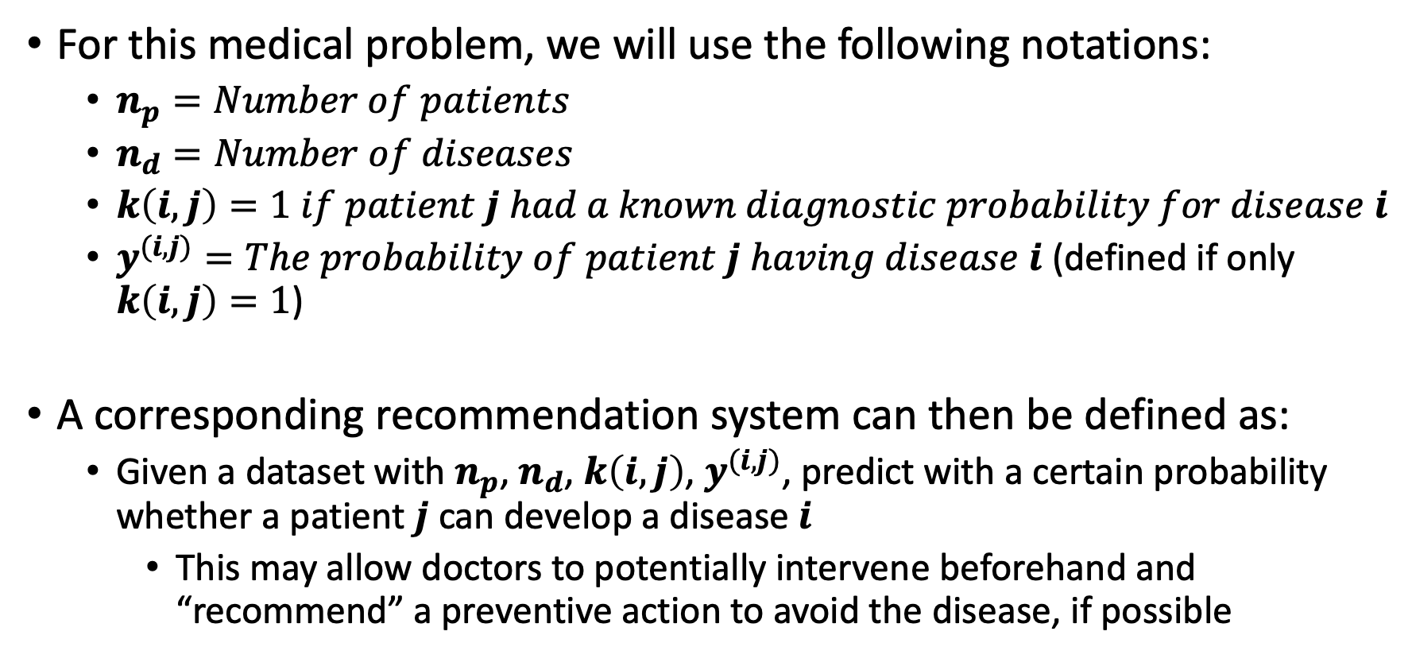
Problem Definition
For this medical problem, we will use the following notations:
  $n_{p}=Number of patients$
  $n_{d}=Number of diseases$
  $k\left(i,j\right)=1 if patient j had a known diagnostic probability for disease i$
  $y^{(i,j)}=The probability of patient j having disease i$ (defined if only $k\left(i,j\right)=1$)
A corresponding recommendation system can then be defined as:
  Given a dataset with $n_{p}$, $n_{d}$, $k\left(i,j\right)$, $y^{(i,j)}$, predict with a certain probability whether a patient $j$ can develop a disease $i$
    This may allow doctors to potentially intervene beforehand and “recommend” a preventive action to avoid the disease, if possible

Slide 9
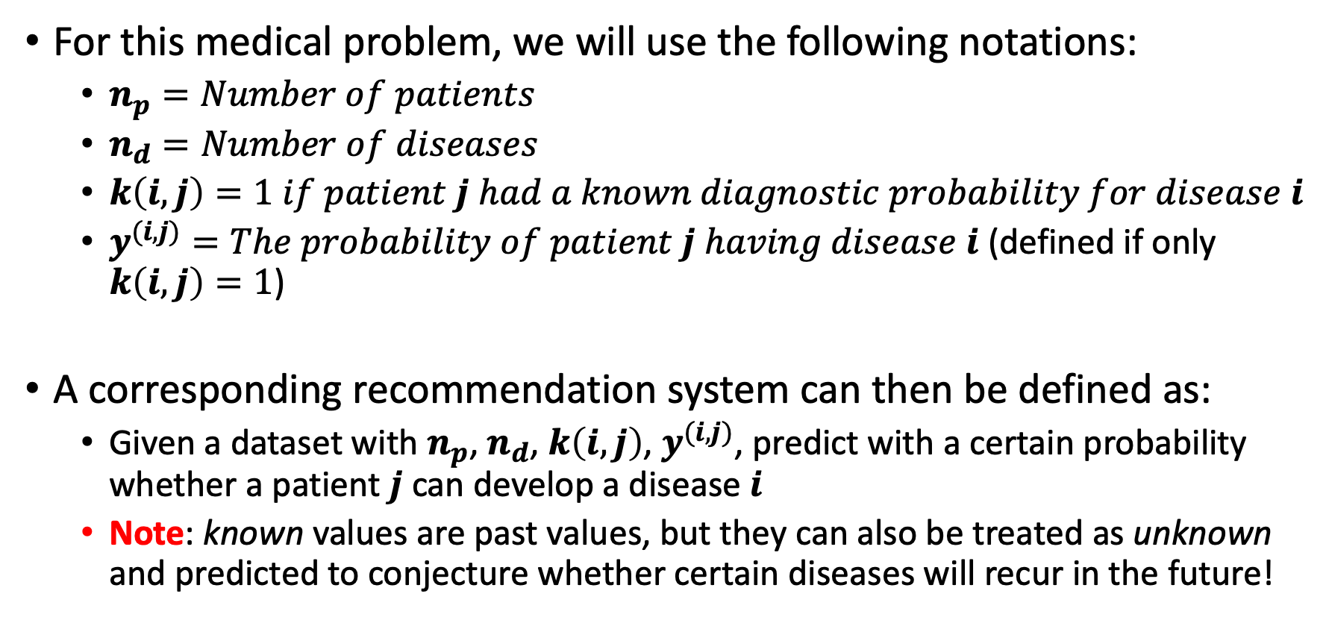
Problem Definition
For this medical problem, we will use the following notations:
  $n_{p}=Number of patients$
  $n_{d}=Number of diseases$
  $k\left(i,j\right)=1 if patient j had a known diagnostic probability for disease i$
  $y^{(i,j)}=The probability of patient j having disease i$ (defined if only $k\left(i,j\right)=1$)
A corresponding recommendation system can then be defined as:
  Given a dataset with $n_{p}$, $n_{d}$, $k\left(i,j\right)$, $y^{(i,j)}$, predict with a certain probability whether a patient $j$ can develop a disease $i$
  Note: known values are past values, but they can also be treated as unknown and predicted to conjecture whether certain diseases will recur in the future!

Slide 10
Outline
Recommendation Systems
Problem Definition
Content-Based Systems
Collaborative Filtering

Slide 11
Content-Based Recommendation System
Consider again our medical problem with a set of diseases and a set of patients as follows
 | Patient 1 | Patient 2 | Patient 3 | Patient 4 | Patient 5 | Pateint 6
Disease 1 | 1 | 1 | ? | ? | ? | ?
Disease 2 | 1 | ? | ? | 0 | 0 | 0
Disease 3 | ? | 0.7 | 0 | ? | ? | ?
Disease 4 | ? | ? | 0.9 | 0.75 | 0.8 | 1
Disease 5 | 0 | 0 | 1 | 1 | 1 | 1

Slide 12
Content-Based Recommendation System
Consider again our medical problem with a set of diseases and a set of patients as follows
 | Patient 1 | Patient 2 | Patient 3 | Patient 4 | Patient 5 | Pateint 6
Disease 1 | 1 | 1 | ? | ? | ? | ?
Disease 2 | 1 | ? | ? | 0 | 0 | 0
Disease 3 | ? | 0.7 | 0 | ? | ? | ?
Disease 4 | ? | ? | 0.9 | 0.75 | 0.8 | 1
Disease 5 | 0 | 0 | 1 | 1 | 1 | 1
How can we predict these missing values?

Slide 13







Content-Based Recommendation System
Suppose that for the given set of diseases there is a set of features (say, symptoms) given as follows
Features
$$x_{1}$$
$$x_{2}$$
$$x_{3}$$
$$x_{4}$$
$$x_{5}$$
$$x_{6}$$
$$x_{7}$$
 | Symptom 1 | Symptom 2 | Symptom 3 | Symptom 4 | Symptom 5 | Symptom 6 | Symptom 7
Disease 1 | 0.9 | 0.2 | 0 | 1 | 0 | 0 | 0.1
Disease 2 | 0.8 | 0.5 | 1 | 0.2 | 0 | 0.6 | 0.5
Disease 3 | 1 | 0 | 0.5 | 0.2 | 0 | 0.3 | 0.4
Disease 4 | 0 | 0 | 0.3 | 0.2 | 0.9 | 0.4 | 0
Disease 5 | 0 | 0 | 0 | 0.2 | 0.75 | 0.1 | 0
Any value is between 0 and 1. For example, 0.8 means that if 100 people have this
disease (i.e., Disease 2), 80 of them will have this symptom (i.e., Symptom 1)

Slide 14


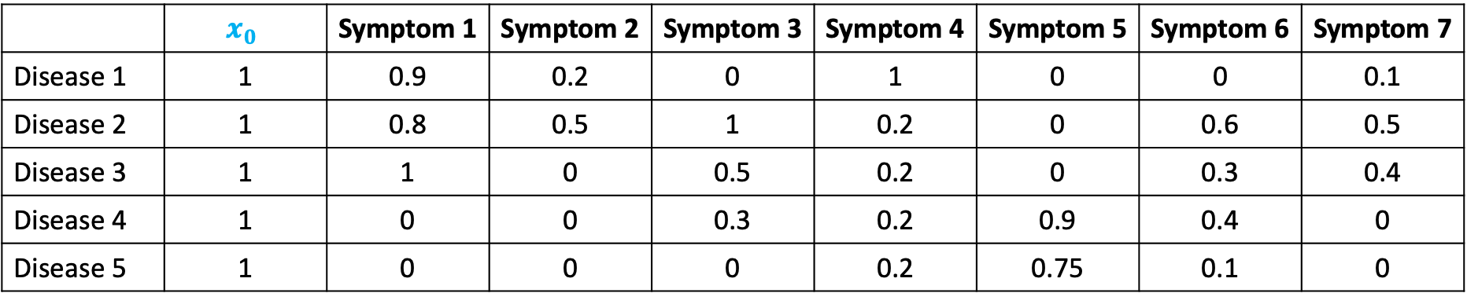

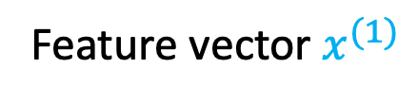


Content-Based Recommendation System
As usual, we also need to add an extra feature that accounts for the intercept when considering a hypothesis function for learning purposes
Features
$$x_{1}$$
$$x_{2}$$
$$x_{3}$$
$$x_{4}$$
$$x_{5}$$
$$x_{6}$$
$$x_{7}$$
 | $$x_{0}$$ | Symptom 1 | Symptom 2 | Symptom 3 | Symptom 4 | Symptom 5 | Symptom 6 | Symptom 7
Disease 1 | 1 | 0.9 | 0.2 | 0 | 1 | 0 | 0 | 0.1
Disease 2 | 1 | 0.8 | 0.5 | 1 | 0.2 | 0 | 0.6 | 0.5
Disease 3 | 1 | 1 | 0 | 0.5 | 0.2 | 0 | 0.3 | 0.4
Disease 4 | 1 | 0 | 0 | 0.3 | 0.2 | 0.9 | 0.4 | 0
Disease 5 | 1 | 0 | 0 | 0 | 0.2 | 0.75 | 0.1 | 0
Feature vector $x^{(1)}$

Slide 15

Content-Based Recommendation System
As usual, we also need to add an extra feature that accounts for the intercept when considering a hypothesis function for learning purposes
Features
$$x_{1}$$
$$x_{2}$$
$$x_{3}$$
$$x_{4}$$
$$x_{5}$$
$$x_{6}$$
$$x_{7}$$
 | $$x_{0}$$ | Symptom 1 | Symptom 2 | Symptom 3 | Symptom 4 | Symptom 5 | Symptom 6 | Symptom 7
Disease 1 | 1 | 0.9 | 0.2 | 0 | 1 | 0 | 0 | 0.1
Disease 2 | 1 | 0.8 | 0.5 | 1 | 0.2 | 0 | 0.6 | 0.5
Disease 3 | 1 | 1 | 0 | 0.5 | 0.2 | 0 | 0.3 | 0.4
Disease 4 | 1 | 0 | 0 | 0.3 | 0.2 | 0.9 | 0.4 | 0
Disease 5 | 1 | 0 | 0 | 0 | 0.2 | 0.75 | 0.1 | 0
Feature vector $x^{(2)}$

Slide 16

Content-Based Recommendation System
As usual, we also need to add an extra feature that accounts for the intercept when considering a hypothesis function for learning purposes
Features
$$x_{1}$$
$$x_{2}$$
$$x_{3}$$
$$x_{4}$$
$$x_{5}$$
$$x_{6}$$
$$x_{7}$$
 | $$x_{0}$$ | Symptom 1 | Symptom 2 | Symptom 3 | Symptom 4 | Symptom 5 | Symptom 6 | Symptom 7
Disease 1 | 1 | 0.9 | 0.2 | 0 | 1 | 0 | 0 | 0.1
Disease 2 | 1 | 0.8 | 0.5 | 1 | 0.2 | 0 | 0.6 | 0.5
Disease 3 | 1 | 1 | 0 | 0.5 | 0.2 | 0 | 0.3 | 0.4
Disease 4 | 1 | 0 | 0 | 0.3 | 0.2 | 0.9 | 0.4 | 0
Disease 5 | 1 | 0 | 0 | 0 | 0.2 | 0.75 | 0.1 | 0
Feature vector $x^{(5)}$

Slide 17







Content-Based Recommendation System
Next, for each patient $j$ we can learn a parameter vector $θ^{(j)}$ using logistic regression
$$θ^{(1)}$$
$$θ^{(2)}$$
$$θ^{(3)}$$
$$θ^{(4)}$$
$$θ^{(5)}$$
$$θ^{(6)}$$
 | Patient 1 | Patient 2 | Patient 3 | Patient 4 | Patient 5 | Pateint 6
Disease 1 | 1 | 1 | ? | ? | ? | ?
Disease 2 | 1 | ? | ? | 0 | 0 | 0
Disease 3 | ? | 0.7 | 0 | ? | ? | ?
Disease 4 | ? | ? | 0.9 | 0.75 | 0.8 | 1
Disease 5 | 0 | 0 | 1 | 1 | 1 | 1

Slide 18







Content-Based Recommendation System
Subsequently, we can predict whether patient $j$ can develop disease $i$ (with a certain probability) by computing $\frac{1}{1+e^{−{{(θ}^{(j)})}^{T}x^{(i)}}}$
  E.g., Let us predict whether patient 1 ($j=1$) will develop disease 4 ($i=4$)
$$θ^{(1)}$$
$$θ^{(2)}$$
$$θ^{(3)}$$
$$θ^{(4)}$$
$$θ^{(5)}$$
$$θ^{(6)}$$
 | Patient 1 | Patient 2 | Patient 3 | Patient 4 | Patient 5 | Pateint 6
Disease 1 | 1 | 1 | ? | ? | ? | ?
Disease 2 | 1 | ? | ? | 0 | 0 | 0
Disease 3 | ? | 0.7 | 0 | ? | ? | ?
Disease 4 | ? | ? | 0.9 | 0.75 | 0.8 | 1
Disease 5 | 0 | 0 | 1 | 1 | 1 | 1
Assume, we have already learnt $θ^{(1)}=[0.5, 0.76, 0.2, 0.1, 0.99, 0.34, 0.81, 0]$

Slide 19








Content-Based Recommendation System
Subsequently, we can predict whether patient $j$ can develop disease $i$ (with a certain probability) by computing $\frac{1}{1+e^{−{{(θ}^{(j)})}^{T}x^{(i)}}}$
  E.g., Let us predict whether patient 1 ($j=1$) will develop disease 4 ($i=4$)
$$x_{1}$$
$$x_{2}$$
$$x_{3}$$
$$x_{4}$$
$$x_{5}$$
$$x_{6}$$
$$x_{7}$$
 | $$x_{0}$$ | Symptom 1 | Symptom 2 | Symptom 3 | Symptom 4 | Symptom 5 | Symptom 6 | Symptom 7
Disease 1 | 1 | 0.9 | 0.2 | 0 | 1 | 0 | 0 | 0.1
Disease 2 | 1 | 0.8 | 0.5 | 1 | 0.2 | 0 | 0.6 | 0.5
Disease 3 | 1 | 1 | 0 | 0.5 | 0.2 | 0 | 0.3 | 0.4
Disease 4 | 1 | 0 | 0 | 0.3 | 0.2 | 0.9 | 0.4 | 0
Disease 5 | 1 | 0 | 0 | 0 | 0.2 | 0.75 | 0.1 | 0
We can then take feature vector $x^{(4)}=[1, 0, 0, 0.3, 0.2, 0.9, 0.4, 0]$ and multiply it by $θ^{(1)}$

Slide 20


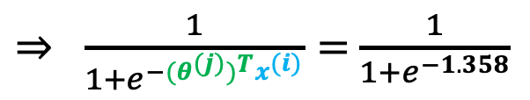
Content-Based Recommendation System
Subsequently, we can predict whether patient $j$ can develop disease $i$ (with a certain probability) by computing $\frac{1}{1+e^{−{{(θ}^{(j)})}^{T}x^{(i)}}}$
  E.g., Let us predict whether patient 1 ($j=1$) will develop disease 4 ($i=4$)
$${{(θ}^{(1)})}^{T}x^{(4)}=\left[\begin{aligned}0.5 \\ 0.76 \\ 0.2 \\ 0.1 \\ 0.99 \\ 0.34 \\ 0.81 \\ 0\end{aligned}\right]\left[1, 0, 0, 0.3, 0.2, 0.9, 0.4, 0\right]=1.358$$
$⇒ \frac{1}{1+e^{−{{(θ}^{(j)})}^{T}x^{(i)}}}=$ $\frac{1}{1+e^{−1.358}}$
$$=0.795$$
  Patient 1 has a chance of 79.5% to develop disease 4

Slide 21


Content-Based Recommendation System
Subsequently, we can predict whether patient $j$ can develop disease $i$ (with a certain probability) by computing $\frac{1}{1+e^{−{{(θ}^{(j)})}^{T}x^{(i)}}}$
  E.g., Let us predict whether patient 1 ($j=1$) will develop disease 4 ($i=4$)
$$θ^{(1)}$$
$$θ^{(2)}$$
$$θ^{(3)}$$
$$θ^{(4)}$$
$$θ^{(5)}$$
$$θ^{(6)}$$
 | Patient 1 | Patient 2 | Patient 3 | Patient 4 | Patient 5 | Pateint 6
Disease 1 | 1 | 1 | ? | ? | ? | ?
Disease 2 | 1 | ? | ? | 0 | 0 | 0
Disease 3 | ? | 0.7 | 0 | ? | ? | ?
Disease 4 | ? | ? | 0.9 | 0.75 | 0.8 | 1
Disease 5 | 0 | 0 | 1 | 1 | 1 | 1
Unknown

Slide 22
Content-Based Recommendation System
Subsequently, we can predict whether patient $j$ can develop disease $i$ (with a certain probability) by computing $\frac{1}{1+e^{−{{(θ}^{(j)})}^{T}x^{(i)}}}$
  E.g., Let us predict whether patient 1 ($j=1$) will develop disease 4 ($i=4$)
$$θ^{(1)}$$
$$θ^{(2)}$$
$$θ^{(3)}$$
$$θ^{(4)}$$
$$θ^{(5)}$$
$$θ^{(6)}$$
 | Patient 1 | Patient 2 | Patient 3 | Patient 4 | Patient 5 | Pateint 6
Disease 1 | 1 | 1 | ? | ? | ? | ?
Disease 2 | 1 | ? | ? | 0 | 0 | 0
Disease 3 | ? | 0.7 | 0 | ? | ? | ?
Disease 4 | 0.795 | ? | 0.9 | 0.75 | 0.8 | 1
Disease 5 | 0 | 0 | 1 | 1 | 1 | 1
Predicted

Slide 23
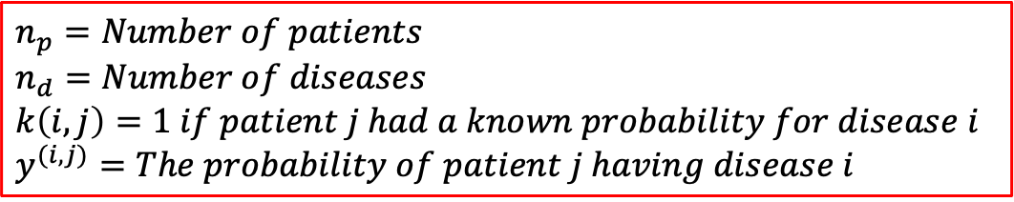

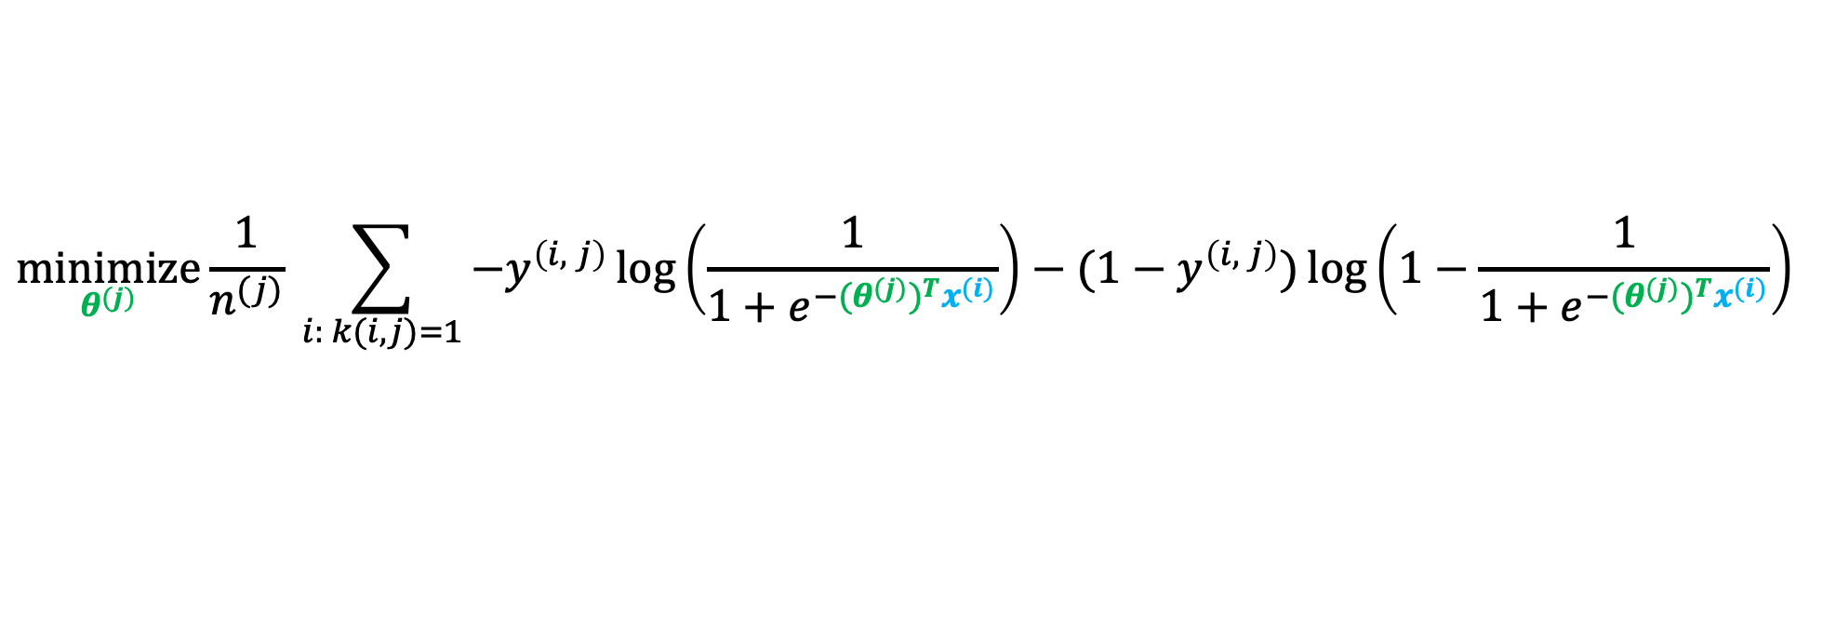
Content-Based Recommendation System
$$n_{p}=Number of patients$$
$$n_{d}=Number of diseases$$
$$k\left(i,j\right)=1 if patient j had a known probability for disease i$$
$$y^{(i,j)}=The probability of patient j having disease i$$
But, how to learn each $θ^{(j)}$?
  By using logistic regression
  That is,
$$\underset{θ^{(j)}}{minimize}{\frac{1}{n^{(j)}} \sum_{i: k(i,j)=1}{−y^{\left(i, j\right)}\log\left(\frac{1}{1+e^{−{{(θ}^{(j)})}^{T}x^{(i)}}}\right)−(1−y^{\left(i, j\right)})\log\left(1−\frac{1}{1+e^{−{{(θ}^{(j)})}^{T}x^{(i)}}}\right) }}$$
Number of diseases patient $j$ was diagnosed for (including when probability was 0)

Slide 24

Content-Based Recommendation System
$$n_{p}=Number of patients$$
$$n_{d}=Number of diseases$$
$$k\left(i,j\right)=1 if patient j had a known probability for disease i$$
$$y^{(i,j)}=The probability of patient j having disease i$$
But, how to learn each $θ^{(j)}$?
  By using logistic regression
  That is,
$$\underset{θ^{(j)}}{minimize}{\frac{1}{n^{(j)}} \sum_{i: k(i,j)=1}{−y^{\left(i, j\right)}\log\left(\frac{1}{1+e^{−{{(θ}^{(j)})}^{T}x^{(i)}}}\right)−(1−y^{\left(i, j\right)})\log\left(1−\frac{1}{1+e^{−{{(θ}^{(j)})}^{T}x^{(i)}}}\right) }}$$
Cost function $J(θ^{(j)})$

Slide 25

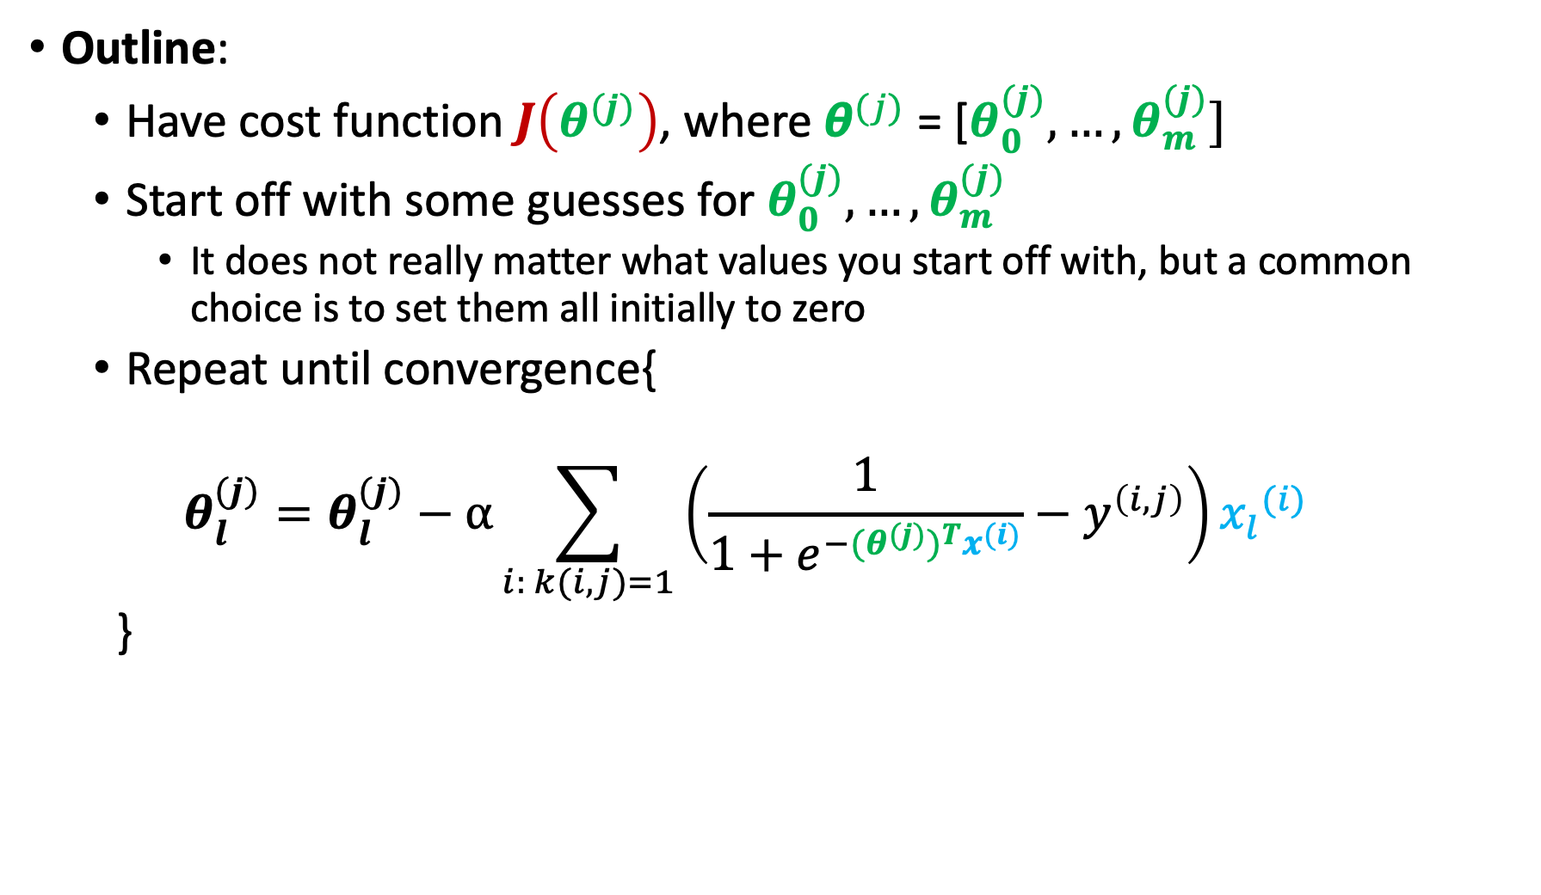
Content-Based Recommendation System
Outline:
  Have cost function $J\left(θ^{(j)}\right)$, where ${\text{θ}}^{(j)}\text{ = [}θ_{0}^{(j)},…,θ_{m}^{(j)}]$
  Start off with some guesses for $θ_{0}^{(j)}, …,θ_{m}^{(j)}$
    It does not really matter what values you start off with, but a common choice is to set them all initially to zero
  Repeat until convergence{
  $$θ_{l}^{(j)}=θ_{l}^{(j)}−α\sum_{i: k(i,j)=1}{\left(\frac{1}{1+e^{−{{(θ}^{(j)})}^{T}x^{(i)}}}−y^{\left(i,j\right)}\right)}{x_{l}}^{(i)}$$
  }
$$0≤l≤m$$

Slide 26







Content-Based Recommendation System
But, why is this system referred to as content-based?
  Because we assume we have at our disposal different features (i.e., symptoms) for different diseases
  And symptoms are “content” of diseases, which we are using to make predictions, hence, the name “content-based” recommendation system
$$θ^{(1)}$$
$$θ^{(2)}$$
$$θ^{(3)}$$
$$θ^{(4)}$$
$$θ^{(5)}$$
$$θ^{(6)}$$
To predict
$θ^{(j)}$
 | Patient 1 | Patient 2 | Patient 3 | Patient 4 | Patient 5 | Pateint 6
Disease 1 | 1 | 1 | ? | ? | ? | ?
Disease 2 | 1 | ? | ? | 0 | 0 | 0
Disease 3 | ? | 0.7 | 0 | ? | ? | ?
Disease 4 | ? | ? | 0.9 | 0.75 | 0.8 | 1
Disease 5 | 0 | 0 | 1 | 1 | 1 | 1
Use the “content”
of diseases

Slide 27
Content-Based Recommendation System
But, why is this system referred to as content-based?
  Because we assume we have at our disposal different features (i.e., symptoms) for different diseases
  And symptoms are “content” of diseases, which we are using to make predictions, hence, the name “content-based” recommendation system
But, for many diseases, it might be difficult to get these features (or more precisely, their values)
Hence, we can use a different approach known as collaborative filtering, which assumes that these values are not necessarily available for us

Slide 28
Outline
Recommendation Systems
Problem Definition
Content-Based Systems
Collaborative Filtering

Slide 29
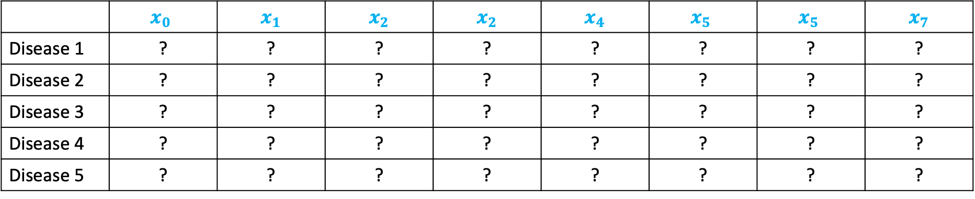
Collaborative Filtering
Suppose that for the given set of diseases there is a set of unknown features that we want to learn
 | $$x_{0}$$ | $$x_{1}$$ | $$x_{2}$$ | $$x_{2}$$ | $$x_{4}$$ | $$x_{5}$$ | $$x_{5}$$ | $$x_{7}$$
Disease 1 | ? | ? | ? | ? | ? | ? | ? | ?
Disease 2 | ? | ? | ? | ? | ? | ? | ? | ?
Disease 3 | ? | ? | ? | ? | ? | ? | ? | ?
Disease 4 | ? | ? | ? | ? | ? | ? | ? | ?
Disease 5 | ? | ? | ? | ? | ? | ? | ? | ?
${We want to learn feature vector x}^{(1)}=[x_{0}^{(1)}$,$x_{1}^{(1)}$,$x_{2}^{(1)}$,$x_{3}^{(1)}$,$x_{4}^{(1)}$,$x_{5}^{(1)}$,$x_{6}^{(1)}$,$x_{7}^{(1)}$]

Slide 30
Collaborative Filtering
Suppose that for the given set of diseases there is a set of unknown features that we want to learn
 | $$x_{0}$$ | $$x_{1}$$ | $$x_{2}$$ | $$x_{2}$$ | $$x_{4}$$ | $$x_{5}$$ | $$x_{5}$$ | $$x_{7}$$
Disease 1 | ? | ? | ? | ? | ? | ? | ? | ?
Disease 2 | ? | ? | ? | ? | ? | ? | ? | ?
Disease 3 | ? | ? | ? | ? | ? | ? | ? | ?
Disease 4 | ? | ? | ? | ? | ? | ? | ? | ?
Disease 5 | ? | ? | ? | ? | ? | ? | ? | ?
${and feature vector x}^{(2)}=[x_{0}^{(2)}$,$x_{1}^{(2)}$,$x_{2}^{(2)}$,$x_{3}^{(2)}$,$x_{4}^{(2)}$,$x_{5}^{(2)}$,$x_{6}^{(2)}$,$x_{7}^{(2)}$]

Slide 31
Collaborative Filtering
Suppose that for the given set of diseases there is a set of unknown features that we want to learn
 | $$x_{0}$$ | $$x_{1}$$ | $$x_{2}$$ | $$x_{2}$$ | $$x_{4}$$ | $$x_{5}$$ | $$x_{5}$$ | $$x_{7}$$
Disease 1 | ? | ? | ? | ? | ? | ? | ? | ?
Disease 2 | ? | ? | ? | ? | ? | ? | ? | ?
Disease 3 | ? | ? | ? | ? | ? | ? | ? | ?
Disease 4 | ? | ? | ? | ? | ? | ? | ? | ?
Disease 5 | ? | ? | ? | ? | ? | ? | ? | ?
${and feature vector x}^{(3)}=[x_{0}^{(3)}$,$x_{1}^{(3)}$,$x_{2}^{(3)}$,$x_{3}^{(3)}$,$x_{4}^{(3)}$,$x_{5}^{(3)}$,$x_{6}^{(3)}$,$x_{7}^{(3)}$]

Slide 32
Collaborative Filtering
Suppose that for the given set of diseases there is a set of unknown features that we want to learn
 | $$x_{0}$$ | $$x_{1}$$ | $$x_{2}$$ | $$x_{2}$$ | $$x_{4}$$ | $$x_{5}$$ | $$x_{5}$$ | $$x_{7}$$
Disease 1 | ? | ? | ? | ? | ? | ? | ? | ?
Disease 2 | ? | ? | ? | ? | ? | ? | ? | ?
Disease 3 | ? | ? | ? | ? | ? | ? | ? | ?
Disease 4 | ? | ? | ? | ? | ? | ? | ? | ?
Disease 5 | ? | ? | ? | ? | ? | ? | ? | ?
${and feature vector x}^{(4)}=[x_{0}^{(4)}$,$x_{1}^{(4)}$,$x_{2}^{(4)}$,$x_{3}^{(4)}$,$x_{4}^{(4)}$,$x_{5}^{(4)}$,$x_{6}^{(4)}$,$x_{7}^{(4)}$]

Slide 33
Collaborative Filtering
Suppose that for the given set of diseases there is a set of unknown features that we want to learn
 | $$x_{0}$$ | $$x_{1}$$ | $$x_{2}$$ | $$x_{2}$$ | $$x_{4}$$ | $$x_{5}$$ | $$x_{5}$$ | $$x_{7}$$
Disease 1 | ? | ? | ? | ? | ? | ? | ? | ?
Disease 2 | ? | ? | ? | ? | ? | ? | ? | ?
Disease 3 | ? | ? | ? | ? | ? | ? | ? | ?
Disease 4 | ? | ? | ? | ? | ? | ? | ? | ?
Disease 5 | ? | ? | ? | ? | ? | ? | ? | ?
${and feature vector x}^{(5)}=[x_{0}^{(5)}$,$x_{1}^{(5)}$,$x_{2}^{(5)}$,$x_{3}^{(5)}$,$x_{4}^{(5)}$,$x_{5}^{(5)}$,$x_{6}^{(5)}$,$x_{7}^{(5)}$]

Slide 34







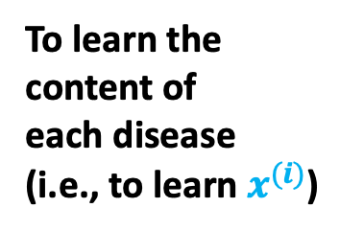
Collaborative Filtering
In contrary, suppose a parameter vector $θ^{(j)}$ is given for every patient
Known
$$θ^{(1)}$$
$$θ^{(2)}$$
$$θ^{(3)}$$
$$θ^{(4)}$$
$$θ^{(5)}$$
$$θ^{(6)}$$
Use $θ^{(j)}$
 | Patient 1 | Patient 2 | Patient 3 | Patient 4 | Patient 5 | Pateint 6
Disease 1 | 1 | 1 | ? | ? | ? | ?
Disease 2 | 1 | ? | ? | 0 | 0 | 0
Disease 3 | ? | 0.7 | 0 | ? | ? | ?
Disease 4 | ? | ? | 0.9 | 0.75 | 0.8 | 1
Disease 5 | 0 | 0 | 1 | 1 | 1 | 1
To learn the
content of
each disease
(i.e., to learn $x^{(i)}$)

Slide 35

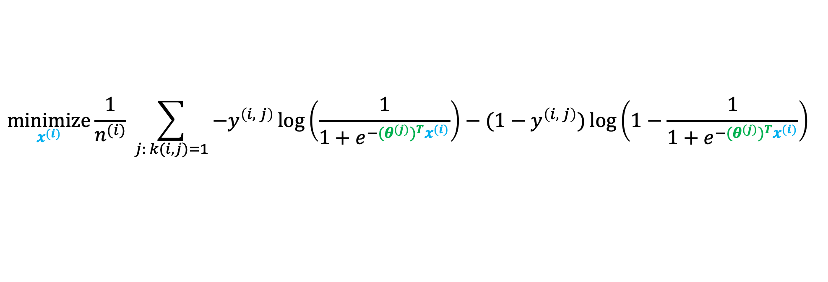
Collaborative Filtering
$$n_{p}=Number of patients$$
$$n_{d}=Number of diseases$$
$$k\left(i,j\right)=1 if patient j had a known probability for disease i$$
$$y^{(i,j)}=The probability of patient j having disease i$$
How to learn each $x^{(i)}$?
  By using logistic regression
  That is,
$$\underset{x^{(i)}}{minimize}{\frac{1}{n^{(i)}} \sum_{j: k(i,j)=1}{−y^{\left(i, j\right)}\log\left(\frac{1}{1+e^{−{{(θ}^{(j)})}^{T}x^{(i)}}}\right)−(1−y^{\left(i, j\right)})\log\left(1−\frac{1}{1+e^{−{{(θ}^{(j)})}^{T}x^{(i)}}}\right) }}$$
Number of patients with disease $i$ (including when probability was 0)

Slide 36

Collaborative Filtering
$$n_{p}=Number of patients$$
$$n_{d}=Number of diseases$$
$$k\left(i,j\right)=1 if patient j had a known probability for disease i$$
$$y^{(i,j)}=The probability of patient j having disease i$$
How to learn each $x^{(i)}$?
  By using logistic regression
  That is,
$$\underset{x^{(i)}}{minimize}{\frac{1}{n^{(i)}} \sum_{j: k(i,j)=1}{−y^{\left(i, j\right)}\log\left(\frac{1}{1+e^{−{{(θ}^{(j)})}^{T}x^{(i)}}}\right)−(1−y^{\left(i, j\right)})\log\left(1−\frac{1}{1+e^{−{{(θ}^{(j)})}^{T}x^{(i)}}}\right) }}$$
Cost function $J(x^{(i)})$

Slide 37
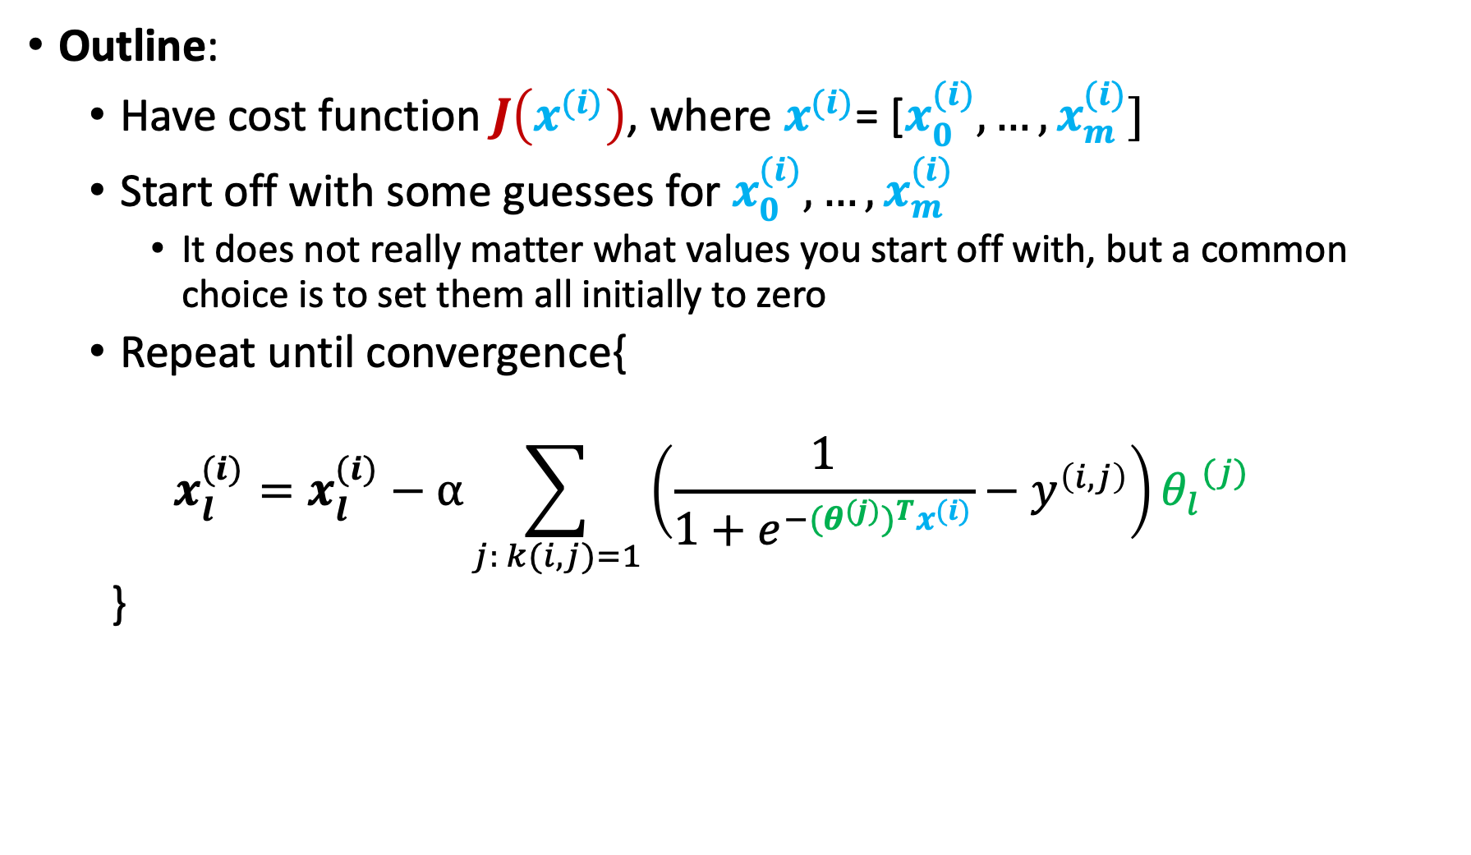
Collaborative Filtering
Outline:
  Have cost function $J\left(x^{(i)}\right)$, where $x^{(i)}\text{= [}x_{0}^{(i)},…,x_{m}^{(i)}]$
  Start off with some guesses for $x_{0}^{(i)}, …,x_{m}^{(i)}$
    It does not really matter what values you start off with, but a common choice is to set them all initially to zero
  Repeat until convergence{
  $$x_{l}^{(i)}=x_{l}^{(i)}−α\sum_{j: k(i,j)=1}{\left(\frac{1}{1+e^{−{{(θ}^{(j)})}^{T}x^{(i)}}}−y^{\left(i,j\right)}\right)}{θ_{l}}^{(j)}$$
  }
$$0≤l≤m$$

Slide 38

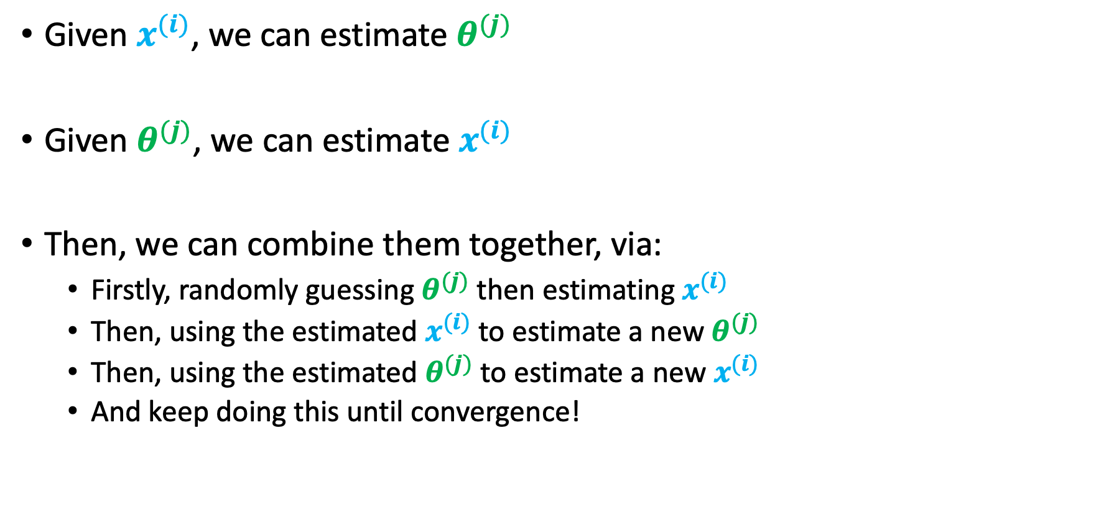
Collaborative Filtering: Putting it All Together
Given $x^{(i)}$, we can estimate $θ^{(j)}$
Given $θ^{(j)}$, we can estimate $x^{(i)}$
Then, we can combine them together, via:
  Firstly, randomly guessing $θ^{(j)}$ then estimating $x^{(i)}$
  Then, using the estimated $x^{(i)}$ to estimate a new $θ^{(j)}$
  Then, using the estimated $θ^{(j)}$ to estimate a new $x^{(i)}$
  And keep doing this until convergence!
The algorithm is called collaborative filtering because every $θ^{(j)}$ is serving in estimating the feature vector $x^{(i)}$, thus ALL collaborating in learning $x^{(i)}$ which can then be used to better predict any diseases $i$ for any patient $j$

Slide 39
Next Wednesday’s Class
Project Presentations

